Slide 1
Description of RGB Game
6 different color squares are displayed, out of which one color’s RGB code is displayed in the header. The user has to guess which color’s RGB code is given.
If the user selects the correct color, then the background color of header and all the other colors changes into the winning color. A message ‘Correct !’ will be displayed.
If the user selects the wrong color, then the selected color changes to the background color. A message ‘Try Again !’ will be displayed.

Slide 2
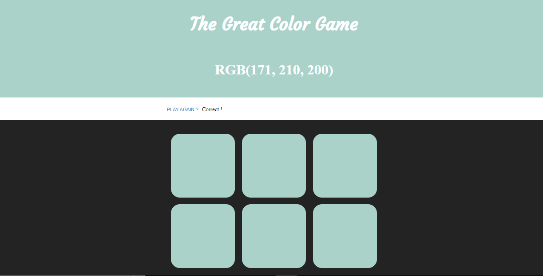
On selecting the correct color :

Slide 3
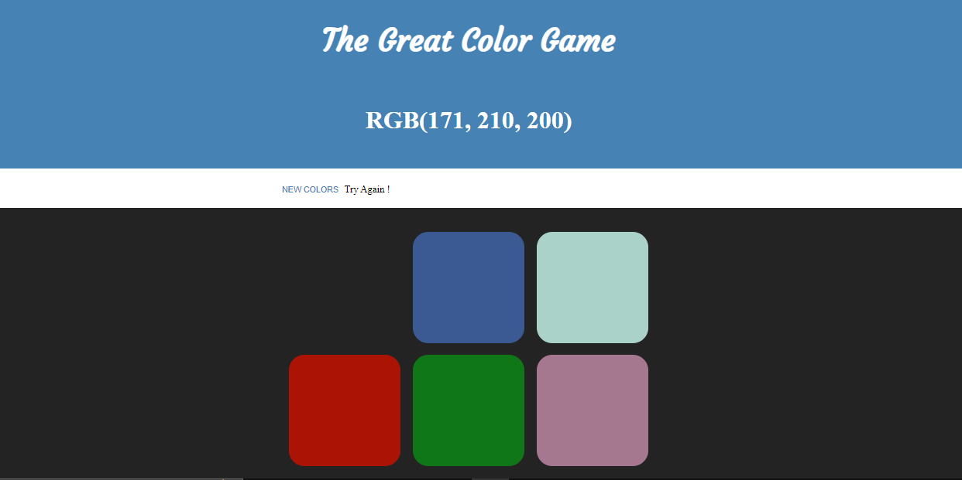
On selecting the wrong color :

Slide 4
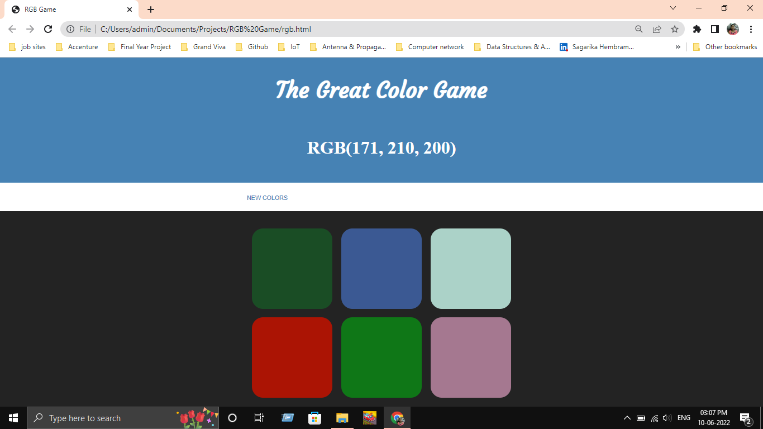
HTML Layout
span id = name
span id = goal
header
h1
button id = reset
div class = options,
div id = btn-container
div id = container
span id = message
div class = square

